Slide 1
FEASIBILITY STUDY
CT026-3-1-Systems Analysis and Design

Slide 2
Topic Learning Outcomes
At the end of this topic, you should be able to:
1. Explain the importance of feasibility study
2. Describe technical feasibility
3. Describe operational feasibility
4. Describe economic feasibility

Slide 3
Contents & Structure
Feasibility Study
Importance of feasibility study
Types of feasibility
Technical
Operational
PIECES Framework
Schedule
Economic
Cost Classification
Benefit Classification

Slide 4
Key terms you must be able to use
If you have mastered this topic, you should be able to use the following terms correctly in your assignments and exams:
Feasibility Study
Technical feasibility
Schedule feasibility
Operational feasibility
Economic feasibility

Slide 5
Recap From Last Lesson
What is system request?

Slide 6
The importance of feasibility study
Why is feasibility study important?
to determine whether a project has a reasonable chance of success.
When are all projects feasible ?
NO tight budgetary & time constraints

Slide 7
Preliminary Investigation Overview
1
Understand the problem and opportunity.
2
Define the project aim, objectives and scopes.
Perform fact-finding (interview, questionnaire/survey, observation, document review or research.
3
Perform feasibility study. (Technical, Economic, Schedule, and Operational)
4
5
Present the recommendation to the management.
Slide 5 (of 22)

Slide 8
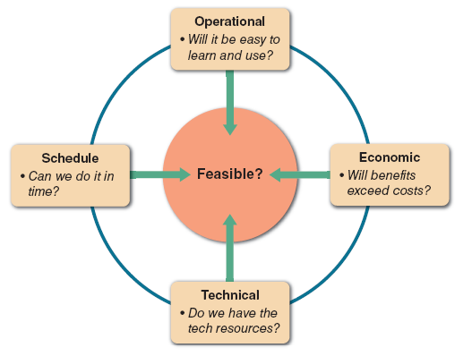
Feasibility study
FIGURE 2-14 A feasibility study examines operational, technical, economic, and schedule factors.

Slide 9
Case Study Scenario
APU want to create a new e-learning website to replace the old one which is slow, dull and insecure. The management did a study and decided a new website can be built within 6 weeks and a budget of RM5,000. They offer a project tender to software developers to create the website. Your company is a software house, interested to take-up the project, therefore do Feasibility Study to evaluate the project.

Slide 10
Technical Feasibility
Process of determining whether the organization has the technology resources to develop or purchase, install, and operate the system.
Is the proposed technology or solution practical?
Yes, similar system is widely used in other universities.
Do we currently possess the necessary technology?
Yes, we have hardware such as ……………………..
Do we possess the necessary technical expertise, and is the schedule reasonable?
Yes we have 2 application programmers and …
If the technology is not available, can it be acquired?
Yes, the applications be purchased from ………

Slide 11
Operational Feasibility
The process of assessing the degree to which a proposed system solves business problems or takes advantage of business opportunities.
Refers to a system that users will accept and use effectively to support business objectives.
The PIECES framework can help identify operational problems to be solved and their urgency.

Slide 12
PIECES framework
Performance
Does the current mode of operation provide adequate throughput and response time?
Is the new system going to be more efficient and high output?
Yes, the new system is going to be THREE times faster and it its going to produce TWO times more output compared to the old.
Information
Does the current mode provide end users and managers with timely, pertinent, accurate and usefully formatted information?
No, the new system has better search and results, generate automatic reports, etc.

Slide 13
PIECES framework
Economy
Does the current mode of operation provide cost-effective information services to the business?
Could there be a reduction in costs and / or an increase in benefits?
Does the proposed system save more cost then older system?
Yes, the new system will allow 20% reduction in maintenance cost. The new system will have less problems to fix.
Control
Does current mode of operation offer effective controls to protect against fraud?
Does current mode of operation guarantee accuracy and security of data and information?
No, the new system is built with latest firewall. The new system have special access to managers to control domain functions.

Slide 14
PIECES framework
Efficiency
Does the current mode of operation make maximum use of available resources, including people, time, flow of forms?
Do you need to hire / let-go people for the new system?
Do we have enough time to print daily report like before?
No, the new system need more people to maintain.
Services
Does the current mode of operation provide reliable service?
Is it flexible and expandable?
Yes, the new system can be easily upgraded, added more applications.

Slide 15
Schedule Feasibility
The process of assessing the degree to which the potential time frame and completion dates for all major activities within a project meet organizational deadlines and constraints for affecting change.
How much time is given for the project by customer?
Estimated 6 weeks
How much time do you need to deliver the system?
(How do you calculate your time? Refer next slide)
Time Needed = 5 weeks
If time insufficient, can we negotiate more from customer?
No, the deadline is strict

Slide 16
Schedule Feasibility
Time Estimation can be done in many ways
One popular method is by using GANTT Chart
You may include a summarized schedules, like an example below:
Tasks | Days
Planning | 4
Analysis | 6
Design | 19
….. | ……
….. | ……
Total | 25 (5 weeks)

Slide 17
Economic feasibility
To concludes if the project can be done within the given budget and to determine the cost and benefit (including profit) from the project.
Consists of 2 tests :
Is the anticipated value of the benefits greater than projected costs of development? (cost / benefit analysis)
Does the organization have adequate cash flow to fund the project during the development period?

Slide 18
Economic feasibility
Cost-Benefit Analysis
Process of identifying the financial benefits and costs associated with a development project
Is performed when:
Conducting a preliminary investigation.
Evaluating a project.
Making recommendations to management.

Slide 19
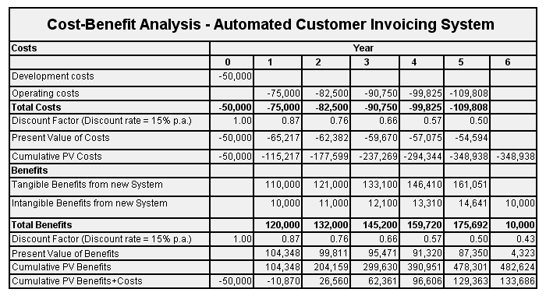

Slide 20
Cost Classifications
Tangible / Intangible costs
tangible costs :
costs for which you can assign a specific dollar value
Example :
employee salaries
hardware and software purchases
office supplies

Slide 21
Cost Classifications
Tangible / Intangible costs
intangible costs :
costs whose dollar value cannot be calculated easily
Example :
customer dissatisfaction
lowered employee morale
reduced information availability

Slide 22
Cost Classifications
Direct / Indirect costs
Direct costs
costs that can be associated with the development of a specific system
Example :
salaries of project team members
purchase of hardware

Slide 23
Cost Classifications
Direct / Indirect costs
Indirect costs
overhead expenses / costs that cannot be attributed to the development of a specific system
Example :
salaries of network administrators
copy machine rentals
insurance expenses

Slide 24
Cost Classifications
Fixed / Variable costs
Fixed costs
costs that are relatively constant and do not depend on a level of activity or effort
Example :
salaries
hardware rentals

Slide 25
Cost Classifications
Fixed / Variable costs
Variable costs
costs that vary depending on the level of activity
Example :
printer paper
supplies
telephone line charges

Slide 26
Cost Classifications
Developmental / Operational costs
Developmental costs
costs that are incurred only once at the time the system is developed or acquired
Example :
salaries of people involved in system
development
software purchases
initial user training
purchase of necessary hardware or furniture

Slide 27
Cost Classifications
Developmental / Operational costs
Operational costs
costs that are incurred after the system is implemented and continue while system is in use
Example :
system maintenance
ongoing training
annual software license fee
communications expenses

Slide 28
Cost Classifications
Some costs apply to more than one category of expenses
Overtime pay for clerical staff during the systems analysis phase would be classified as developmental, variable, and direct
A monthly fee for maintaining the company’s Web site would be regarded as operational, fixed, and indirect
Managing Information Systems Costs and Charges
Direct costs usually are easier to identify and predict than indirect costs

Slide 29
Benefit Classifications
Benefit Classifications
Like costs, benefits can be classified as tangible or intangible, fixed or variable, and direct or indirect
Positive benefits increase revenues, improve services, or otherwise contribute to the organization as a direct result of the new information system.
Cost-avoidance benefits refer to expenses that would be necessary if the new system were not installed.

Slide 30
Benefit Classifications
Benefits can be classified as :
Tangible / Intangible benefits
Direct / Indirect benefits
Fixed / Variable benefits
Developmental / Operational benefits
Another useful benefit classification relates to the nature of the benefit :
Positive / Cost-avoidance benefits

Slide 31
Benefit Classifications
Positive / Cost-avoidance benefits
Positive benefits
Benefits that are a direct result of the new information system.
Example :
Increased revenues
Improved services
Higher morale
Better management

Slide 32
Benefit classifications
Positive / Cost-avoidance benefits
Cost avoidance benefits
Expenses that would be necessary if the new system is not installed.
Example :
Handling work with current staff instead of hiring
Not having to replace hardware and software

Slide 33
Cost-Benefit Formula
COST-BENEFIT RATIO
BENEFITS
COSTS

Slide 34
Cost-Benefit Analysis: Case Study
 | Develop In-House System | Off-Shelf System
Cost
Consultation | 700 | 0
Hardware/Software | 1,500 | 2,000
Implementation | 500 | 1,000
Maintenance | 300 | 500
Total Cost | 3,000 | 3,500
Benefit
Additional Profit | 7,500 | 8,000
Reduction of employee | ************** | **************
Total Benefit | 7,500 | 8,000
Cost-Benefit Ratio | 2.5 | 2.3
Pick solution that gives the HIGHEST ratio.

Slide 35
Economic Feasibility
To concludes if the project can be done within the given budget and to determine the cost and benefit (including profit) from the project.
How much is the project’s budget?
Estimated RM5,000
How much is our cost?
(How do you calculate your cost? Refer next slide)
Cost = RM3,000
How much is our profit?
(Budget – Cost) = Profit = RM 2,000
Does the organization have adequate cash flow to fund the project during the development period?
Yes, the company has RM 10,000 in their reserve, therefore it is ECONOMICALLY FEASIBLE.

Slide 36
Extras – Pros, Cons, Formulas
https://www.investopedia.com/terms/c/cost-benefitanalysis.asp
https://www.wallstreetmojo.com/cost-benefit-analysis-formula/
*For self-reading and group assignment discussion

Slide 37
Summary
Feasibility Study
Types of feasibility
Economic
Cost Classification
Benefit Classification

Slide 38
Question and Answer Session
Q & A

Slide 39
What To Expect Next Week
In Class
Preparation for Class
System Analysis – Requirements
Download the slide and study for the next chapter.

